Slide 1
Tackling TB in Urban Areas KACHCON 2015 31 October 2015 Yenepoya Medical College
Dr. Sangeetha Kodkani
Senior Specialist &
Head, Drug Resistant TB Diagnostic Laboratory
Bangalore

Slide 2
Theme
Reaching the Unreached

Slide 3
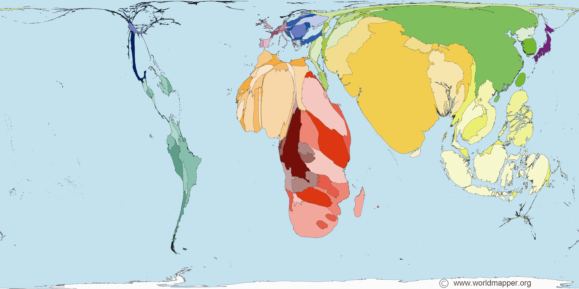
Burden of Tuberculosis: Global and India
Global*:
Incidence – 9million
Deaths – 1.5 million; 320,000 among HIV+ (3.7%)
HIV co-infection – 1.1 million (13%)
‘Missing’ TB Cases: 2.9 million (34%)
India*:
Incidence – 2.1 million; 26% of global TB
Deaths – 270,000; 42,000 among HIV+ (1.9%)
HIV co-infection – 130,000 (5.9%)
‘Missing’ TB Cases: 1000,000 (33%)
*WHO Global TB Report 2013; $WHO TB Country Profiles, 2013 & 14

Slide 4
TB Burden - India
Estimates of TB burden * 2013 | Number | Rate (per 100 000 population)
Mortality (excludes HIV+TB) | 240,000 | 19
Mortality (HIV+TB only) | 38,000 | 3
Prevalence (includes HIV+TB) | 2 600,000 | 211
Incidence (includes HIV+TB) | 2 100,000 | 171
Incidence (HIV+TB only) | 120,000 | 9.7
Case detection, all forms (%) | 58,000 | India TB Report 2014

Slide 5
India – Burden of the disease
25% of the global incidence of an estimated 9 million
Third leading cause of death among women of reproductive age (15-44 years)
The direct and indirect costs of TB to India amount to an estimated $23.7 billion annually
An average 3 to 4 months of work time is lost as result of TB, resulting in an average loss of potential earning of 20-30% of the annual household income

Slide 6
Urban Scenario
The urban slum population in India increased to 65.5 million in 2011 from 43 million in 2001 & at the time was projected to grow at 5% annually
At about 8%, TB is the leading cause of death from infectious disease in urban India among productive adults (16-70 years)
Despite perceived proximity of the urban poor to urban health facilities, access to standardized, high quality TB services is limited.

Slide 7
Urban Scenario
TB control program is predominantly rural
Urban TB control is organized on an ad-hoc basis
Wide variety of health providers
Provision of health care is predominantly private

Slide 8
Operational Challenges
Deficient public health infrastructure
Poor quality of services rendered by private care
Migration of people
Lack of follow-up of patients

Slide 9
Sociological Challenges
People living in slums
Migration
Substance abuse
Health inequalities
Differential exposure and susceptibility
Vulnerable groups

Slide 10
Communities in Urban Area
Communities at risk to TB
Occupation:
Migrants
Miners
Behaviours:
Smoking
Alcohol? Substance abuse
Demographic:
Age: Young and elderly
Location: Urban slum
Status: Illiteracy
Income: Poor
Immune status:
People living with HIV
People with Diabetes

Slide 11
Providers in Urban Area – who see TB
Doctors:
Practitioners of Modern Medicine (Allopathic)
GP or Specialist
ISMH / (AYUSH)
Less than fully qualified
Pharmacists/ Chemists:
Laboratories:
Clinic Assistants:
Receptionist
Nurse

Slide 12
The need
➔Universal adoption of standards of tuberculosis care

Slide 13
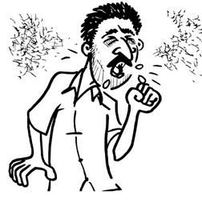
Interface to connect
Public Sector (RNTCP)
Private Health Sector
Advocacy
Information exchange
Coordination
Patient, Family &
Community
Capacity building
Support
Feedback
Local advocacy
Communication
CS referral
Care & support

Slide 14
Focus of Urban TB intervention
Identify and manage of ‘missing’ TB patients by
Strengthening basic TB services in urban areas
Increased access to TB care
Integration of service providers
Flexible and innovative TB approaches
To find practices to target vulnerable population
Stronger linkage to TB control program
Reduce delays in private sector TB diagnosis and treatment
⇨ Reduce morbidity and mortality
⇨ Reduce costs
Ensure high treatment compliance in private sector
⇨ Reduce risk/spread of drug-resistant TB
⇨ Reduce spread of TB

Slide 15
Interventions….
Awareness
ICT based teaching
Capacity building

Slide 16
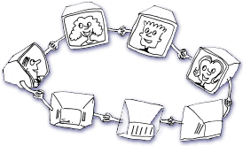
Network formation: Relationship building
Provider exchange forum
Continue learning process
Critical support services
Peer learning
Factsheets
Technical support visits
Documentation support
Access to RNTCP services
Treatment support
Training paramedical staff

Slide 17
ACSM activities
Robust IEC activities
Awareness on TB through multiple channels of communication

Slide 18
Improved case finding
Risk stratification
Addressing co-morbid and multi-morbid conditions
Offering rapid diagnostics
Engaging with private laboratories and private providers

Slide 19
Management
Patient-centric approach
Community-based treatment centres
Promoting rational use of anti-TB drugs
Disseminating STCI
Improved data management systems
Social support program
NGO/PP interventions

Slide 20
Management
Contact tracing
Infection control in health care settings
Preventive treatment to vulnerable population

Slide 21
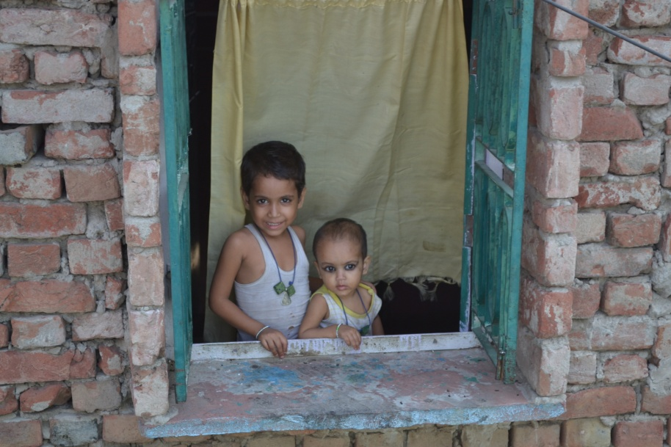
Thanks
The next generation will receive the highest standards of care & support from healthcare providers of their choice

